Slide 1
Electromagnetic Theory

Slide 2
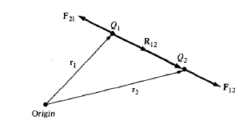



Coulomb’s Law
It states that the force F between two point charges Q₁ and Q₂ is
In Vector form
Or
If we have more than two point charges

Slide 3


Electric Field Intensity
Electric Field Intensity is the force per unit charge when placed in the electric field
In Vector form
E
If we have more than two point charges

Slide 4
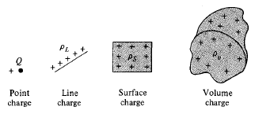


Electric Field due to Continuous Charge Distribution
If there is a continuous charge distribution say along a line, on a surface, or in a volume
The charge element dQ and the total charge Q due to these charge distributions can be obtained by

Slide 5




The electric field intensity due to each charge distribution ρ_{L}, ρ_{S} and ρ_{V} may be given by the summation of the field contributed by the numerous point charges making up the charge distribution.

Slide 6


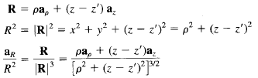
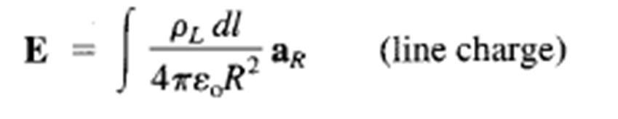
A Line charge

Slide 8



For finite line charge
For infinite line charge
$A \left(0,0,−∞\right)and B\left(0,0,∞\right); α_{1}=\frac{π}{2}, α_{2}=−\frac{π}{2}$

Slide 9
Electric field for a surface charge i.e. infinite long sheet is given by
Electric field for a volume charge

Slide 10

Electric Flux Density
The electric field intensity depends on the medium in which the charges are placed.
Suppose a vector field D independent of the medium is defined by
The electric flux ψ in terms of D can be defined as
The vector field D is called the electric flux density and is measured in coulombs per square meter.

Slide 11


Electric Flux Density
For an infinite sheet the electric flux density D is given by
For a volume charge distribution the electric flux density D is given by
In both the above equations D is a function of charge and position only (independent of medium)

Slide 12



Gauss Law
It states that the total electric flux ψ through any closed surface is equal to the total charge enclosed by that surface.
(i)

Slide 13

Using Divergence Theorem
(ii)
Comparing the two volume integrals in (i) and (ii)
This is the first Maxwell’s equation.
It states that the volume charge density is the same as the divergence of the electric flux density.

Slide 14
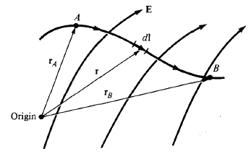
Electric Potential
Electric Field intensity, E due to a charge distribution can be obtained from Coulomb’s Law.
or using Gauss Law when the charge distribution is symmetric.
We can obtain E without involving vectors by using the electric scalar potential V.
From Coulomb’s Law the force on point
charge Q is
The work done in displacing the charge
by length dl is
The negative sign indicates that the work is being done by an external agent.

Slide 15
The total work done or the potential energy required in moving the point charge Q from A to B is
Dividing the above equation by Q gives the potential energy per unit charge.
is known as the potential difference between points A and B.
1. If is negative, there is loss in potential energy in moving Q from A to B (work is being done by the field), if is positive, there is a gain in potential energy in the movement (an external agent does the work).
2. It is independent of the path taken. It is measured in Joules per Coulomb referred as Volt.

Slide 16
The potential at any point due to a point charge Q located at the origin is
The potential at any point is the potential difference between that point and a chosen point at which the potential is zero.
Assuming zero potential at infinity, the potential at a distance r from the point charge is the work done per unit charge by an external agent in transferring a test charge from infinity to that point.
If the point charge Q is not at origin but at a point whose position vector is , the potential at becomes

Slide 17



For n point charges Q₁, Q₂, Q₃…..Q_{n} located at points with position vectors the potential at is
If there is continuous charge distribution instead of point charges then the potential at becomes

Slide 18
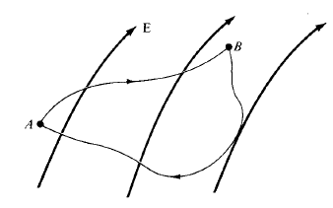
Relationship between E and V
The potential difference between points A and B is independent of the path taken
and
(i)
It means that the line integral of along a closed path must be zero.

Slide 19
Physically it means that no net work is done in moving a charge along a closed path in an electrostatic field.
Applying Stokes’s theorem to equation (i)
(ii)
Equation (i) and (ii) are known as Maxwell’s equation for static electric fields.
Equation (i) is in integral form while equation (ii) is in differential form, both depicting conservative nature of an electrostatic field.

Slide 20
Also
It means Electric Field Intensity is the gradient of V.
The negative sign shows that the direction of is opposite to the direction in which V increases.

Slide 21
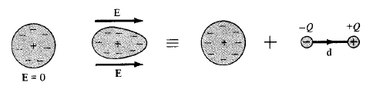
Polarization in Dielectrics
Consider an atom of the dielectric consisting of an electron cloud (-Q) and a positive nucleus (+Q).
When an electric field is applied, the positive charge is displaced from its equilibrium position in the direction of by while the negative charge is displaced by in the opposite direction.
A dipole results from the displacement of charges and the dielectric is polarized. In polarized the electron cloud is distorted by the applied electric field.

Slide 22


This distorted charge distribution is equivalent to the original distribution plus the dipole whose moment is
where is the distance vector between -Q to +Q.
If there are N dipoles in a volume Δv of the dielectric, the total dipole moment due to the electric field
For the measurement of intensity of polarization, we define polarization (coulomb per square meter) as dipole moment per unit volume

Slide 23
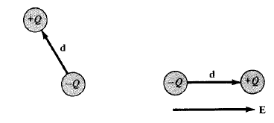
The major effect of the electric field on the dielectric is the creation of dipole moments that align themselves in the direction of electric field.
This type of dielectrics are said to be non-polar. eg: H₂, N₂, O₂
Other types of molecules that have in-built permanent dipole moments are called polar. eg: H₂O, HCl
When electric field is applied to a polar material then its permanent dipole experiences a torque that tends to align its dipole moment in the direction of the electric field.

Slide 24

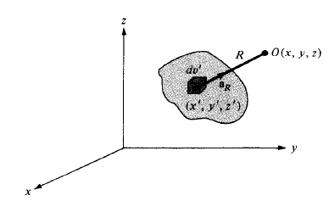


Field due to a Polarized Dielectric
Consider a dielectric material consisting of dipoles with Dipole moment per unit volume.
The potential dV at an external point O due to
(i)
where R² = (x-x’)²+(y-y’)²+(z-z’)² and R is the distance between volume element dv’ and the point O.
But
Applying the vector identity
= -

Slide 25




Put this in (i) and integrate over the entire volume v’ of the dielectric
Applying Divergence Theorem to the first term
(ii)
where a_{n}’ is the outward unit normal to the surface dS’ of the dielectric
The two terms in (ii) denote the potential due to surface and volume charge distributions with densities

Slide 26


where ρ_{ps} and ρ_{pv} are the bound surface and volume charge densities.
Bound charges are those which are not free to move in the dielectric material.
Equation (ii) says that where polarization occurs, an equivalent volume charge density, ρ_{pv} is formed throughout the dielectric while an equivalent surface charge density, ρ_{ps} is formed over the surface of dielectric.
The total positive bound charge on surface S bounding the dielectric is
while the charge that remains inside S is

Slide 27

Total charge on dielectric remains zero.
Total charge =
When dielectric contains free charge
If ρ_{v} is the free volume charge density then the total volume charge density ρ_{t}
Hence
Where

Slide 28
The effect of the dielectric on the electric field is to increase inside it by an amount .
The polarization would vary directly as the applied electric field.
Where is known as the electric susceptibility of the material
It is a measure of how susceptible (or sensitive) a given dielectric is to electric fields.

Slide 29

Dielectric Constant and Strength
We know that
and
Thus
or
where
and
where є is the permittivity of the dielectric, є_{o} is the permittivity of the free space and є_{r} is the dielectric constant or relative permittivity.

Slide 30
No dielectric is ideal. When the electric field in a dielectric is sufficiently high then it begins to pull electrons completely out of the molecules, and the dielectric becomes conducting.
When a dielectric becomes conducting then it is called dielectric breakdown. It depends on the type of material, humidity, temperature and the amount of time for which the field is applied.
The minimum value of the electric field at which the dielectric breakdown occurs is called the dielectric strength of the dielectric material.
or
The dielectric strength is the maximum value of the electric field that a dielectric can tolerate or withstand without breakdown.

Slide 31



Continuity Equation and Relaxation Time
According to principle of charge conservation, the time rate of decrease of charge within a given volume must be equal to the net outward current flow through the closed surface of the volume.
The current I_{out} coming out of the closed surface
(i)
where Q_{in} is the total charge enclosed by the closed surface.
Using divergence theorem
But

Slide 32



Equation (i) now becomes
or
(ii)
This is called the continuity of current equation.
Effect of introducing charge at some interior point of a conductor/dielectric
According to Ohm’s law
According to Gauss’s law

Slide 33




Equation (ii) now becomes
or
This is homogeneous liner ordinary differential equation. By separating variables we get
Integrating both sides

Slide 34

(iii)
where
Equation (iii) shows that as a result of introducing charge at some interior point of the material there is a decay of the volume charge density ρ_{v}.
The time constant T_{r} is known as the relaxation time or the rearrangement time.
Relaxation time is the time in which a charge placed in the interior of a material to drop to e⁻¹ = 36.8 % of its initial value.
For Copper T_{r} = 1.53 x 10⁻¹⁹ sec (short for good conductors)
For fused Quartz T_{r} = 51.2 days (large for good dielectrics)

Slide 35


Boundary Conditions
If the field exists in a region consisting of two different media, the conditions that the field must satisfy at the interface separating the media are called boundary conditions
These conditions are helpful in determining the field on one side of the boundary when the field on other side is known.
We will consider the boundary conditions at an interface separating
Dielectric (є_{r1}) and Dielectric (є_{r2})
Conductor and Dielectric
Conductor and free space
For determining boundary conditions we will use Maxwell’s equations
and

Slide 36
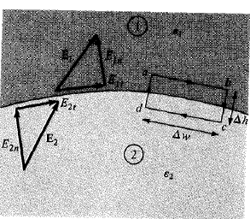

1.Boundary Conditions (Between two different dielectrics)
Consider the E field existing in a region consisting of two different dielectrics characterized by є₁ = є₀ є_{r1} and є₂ = є₀ є_{r2}
E₁ and E₂ in the media 1 and 2 can be written as
and
But
Assuming that the path abcda is very small with respect to the variation in E

Slide 37


As Δh 0
Thus the tangential components of E are the same on the two sides of the boundary. E is continuous across the boundary.
But
Thus
or
Here D_{t} undergoes some change across the surface and is said to be discontinuous across the interface.

Slide 38
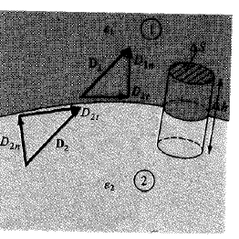


Applying
Putting Δh 0 gives
Where ρ_{s} is the free charge density placed deliberately at the boundary
If there is no charge on the boundary i.e. ρ_{s} = 0 then
Thus the normal components of D is continuous across the surface.

Slide 39

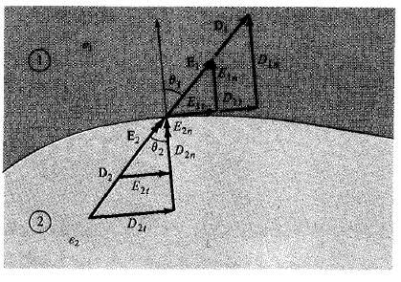




Refraction of electric field across boundary

Slide 40
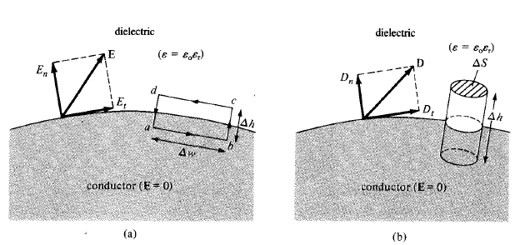

2. Boundary Conditions (conductor-dielectric)

Slide 41




Under static conditions, following conclusions can be made: 1. No electric field exist inside the conductor 2. There will be no potential difference between any points inside the conductor. The conductor is called equipotential body. 3. Electric field can be external to the conductor or normal to the surface
Inside the conductor

Slide 42

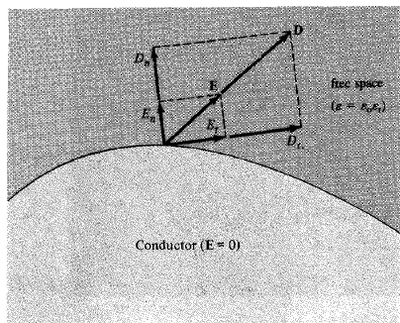
3. Boundary Conditions (conductor - free space)
For a free space ε_{r} = 1

Slide 43

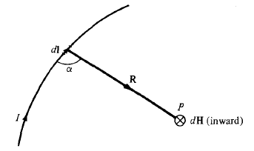


Biot-Savart’s Law
It states that the magnetic field intensity dH produce at a point P by the differential current element Idl is proportional to the product Idl and the sine of angle α between the element and line joining P to the element and is inversely proportional to the square of distance R between P and the element.
or
The direction of dH can be determined by the right hand thumb rule with the right hand thumb pointing in the direction of the current, the right hand fingers encircling the wire in the direction of dH

Slide 44
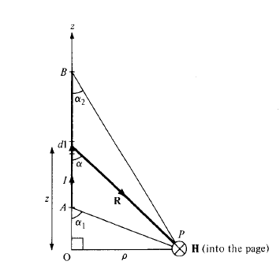
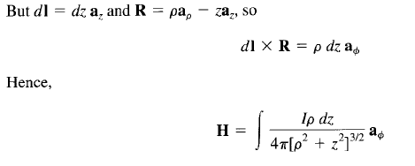

Application of Biot-Savart’s Law

Slide 45



Ampere’s circuit Law
The line integral of the tangential component of H around a close path is the same as the net current I_{inc} enclosed by the path.
Using Stoke’s law
But
Comparing we get
This is third maxwell equation

Slide 46
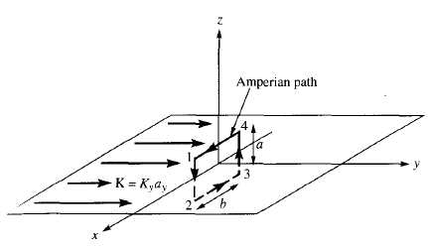

Application of Ampere’s law : Infinite Sheet Current
Consider an infinite current sheet in z = 0 plane.
If the sheet has a uniform current density then
Applying Ampere’s Law on closed rectangular path (Amperian path) we get
(i)
To solve integral we need to know how H is like
We assume the sheet comprising of filaments dH above and below the sheet due to pair of filamentary current.

Slide 47

The resultant dH has only an x-component.
Also H on one side of sheet is the negative of the other.
Due to infinite extent of the sheet, it can be regarded as consisting of such filamentary pairs so that the characteristic of H for a pair are the same for the infinite current sheets
(ii)
where H_{o} is to be determined.

Slide 48


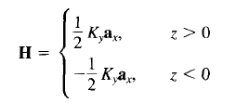
Evaluating the line integral of H along the closed path
(iii)
Comparing (i) and (iii), we get
(iv)
Using (iv) in (ii), we get

Slide 49

Generally, for an infinite sheet of current density K
where a_{n} is a unit normal vector directed from the current sheet to the point of interest.

Slide 50

Magnetic Flux Density
The magnetic flux density B is similar to the electric flux density D
Therefore, the magnetic flux density B is related to the magnetic field intensity H
where µ_{o} is a constant and is known as the permeability of free space.
Its unit is Henry/meter (H/m) and has the value
The magnetic flux through a surface S is given by
where the magnetic flux ψ is in webers (Wb) and the magnetic flux density is in weber/ square meter or Teslas.

Slide 51
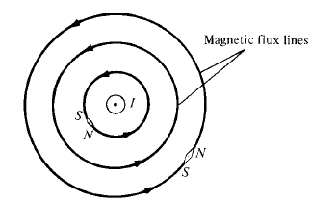
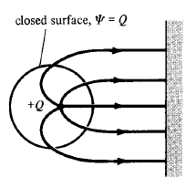
Magnetic flux lines due to a straight wire with current coming out of the page
Each magnetic flux line is closed with no beginning and no end and are also not crossing each other.
In an electrostatic field, the flux passing through a closed surface is the same as the charge enclosed.
Thus it is possible to have an isolated electric charge.
Also the electric flux lines are not necessarily closed.

Slide 52
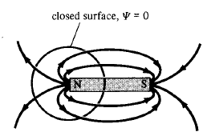

Magnetic flux lines are always close upon themselves,.
So it is not possible to have an isolated magnetic pole (or magnetic charges)
An isolated magnetic charge does not exist.
Thus the total flux through a closed surface in a magnetic field must be zero.
This equation is known as the law of conservation of magnetic flux or Gauss’s Law for Magnetostatic fields.
Magnetostatic field is not conservative but magnetic flux is conserved.

Slide 53

Applying Divergence theorem, we get
or
This is Maxwell’s fourth equation.
This equation suggests that magnetostatic fields have no source or sinks.
Also magnetic flux lines are always continuous.

Slide 54

Faraday’s law
According to Faraday a time varying magnetic field produces an induced voltage (called electromotive force or emf) in a closed circuit, which causes a flow of current.
The induced emf (V_{emf}) in any closed circuit is equal to the time rate of change of the magnetic flux linkage by the circuit. This is Faraday’s Law and can be expressed as
where N is the number of turns in the circuit and ψ is the flux through each turn.
The negative sign shows that the induced voltage acts in such a way to oppose the flux producing in it. This is known as Lenz’s Law.

Slide 55


Transformer and Motional EMF
For a circuit with a single turn (N = 1)
In terms of E and B this can be written as
(i)
where ψ has been replaced by and S is the surface area of the circuit bounded by a closed path L..
The equation says that in time-varying situation, both electric and magnetic fields are present and are interrelated.

Slide 56
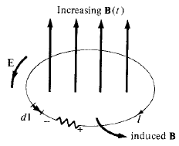

The variation of flux with time may be caused in three ways.
By having a stationary loop in a time-varying B field.
By having a time-varying loop area in a static B field.
By having a time-varying loop area in a time-varying B field.
Stationary loop in a time-varying B field (Transformer emf)
Consider a stationary conducting loop in a time-varying magnetic B field. The equation (i) becomes

Slide 57


This emf induced by the time-varying current in a stationary loop is often referred to as transformer emf in power analysis since it is due to the transformer action.
By applying Stokes’s theorem to the middle term, we get
Thus
This is one of the Maxwell’s equations for time-varying fields.
It shows that the time-varying field is not conservative.

Slide 58


2. Moving loop in static B field (Motional emf)
When a conducting loop is moving in a static B field, an emf is introduced in the loop.
The force on a charge moving with uniform velocity u in a magnetic field B is
The motional electric field E_{m} is defined as
Consider a conducting loop moving with uniform velocity u, the emf induced in the loop is
(i)
This kind of emf is called the motional emf or flux-cutting emf. Because it is due to the motional action. eg,. Motors, generators

Slide 59

By applying Stokes’s theorem to equation (i), we get

Slide 60


3. Moving loop in time-varying field
Consider a moving conducting loop in a time-varying magnetic field
Then both transformer emf and motional emf are present.
Thus the total emf will be the sum of transformer emf and motional emf
also

Slide 61

Displacement Current
For static EM fields
(i)
But the divergence of the curl of a vector field is zero. So
(ii)
But the continuity of current requires
(iii)
Equation (ii) and (iii) are incompatible for time-varying conditions
So we need to modify equation (i) to agree with (iii)
Add a term to equation (i) so that it becomes
(iv)
where J_{d} is to defined and determined.

Slide 62




Again the divergence of the curl of a vector field is zero. So
(v)
In order for equation (v) to agree with (iii)
or
(vi)
Putting (vi) in (iv), we get
This is Maxwell’s equation (based on Ampere Circuital Law) for a time-varying field. The term is known as displacement current density and J is the conduction current density .

Slide 63
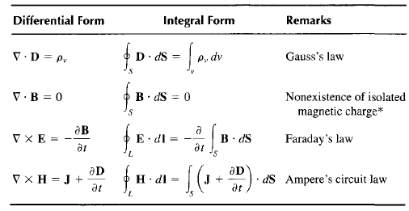
Maxwell’s Equations in Final Form

